Slide 1
An Image is Worth 16x16 Words: Transformers for Image Recognition at Scale
Alexey Dosovitskiy et. al ICLR 2021
https://arxiv.org/abs/2010.11929

Slide 2
Contributions
Transformers in computer vision: applying attention to image patches
When pretrained on large amounts of data and transferred to multiple mid- or small- image recognition benchmarks, Vision Transformer (ViT) achieves results comparable to SotA convolutional neural networks while requiring fewer resources to train

Slide 3
Motivation
Self-attention-based architectures, i.e., Transformers have been very popular in NLP
Dominant approach is to pre-train on a large text corpus then fine-tune on a smaller task-specific dataset
Transformers are also computationally efficient and scalable (billions of parameters, larger data), no sign of saturating performance

Slide 4
Motivation
In computer vision, convolutional architectures (CNNs) remain dominant
Multiple works try to combine CNN with self-attention, but haven’t scaled effectively
In large-scale image recognition, classic ResNet-like architectures are still state-of-the-art

Slide 5
This Work
Experiment with applying standard Transformer directly to images with fewest possible modifications:
Split an image into patches
Provide the sequence of linear embeddings of these patches as an input to a Transformer
Key: image patches as tokens (words) in NLP applications

Slide 6
Findings
When trained on mid-sized datasets (ImageNet), Transformers yield modest accuracies (a few % below ResNet of comparable size) – expected since Transformers lack inductive biases that CNNs have (e.g., locality) thus do not generalize well when trained on small amount of data
But, if trained on larger datasets (14M-300M images), large scale training trumps inductive bias – beat SotA on multiple benchmarks

Slide 7
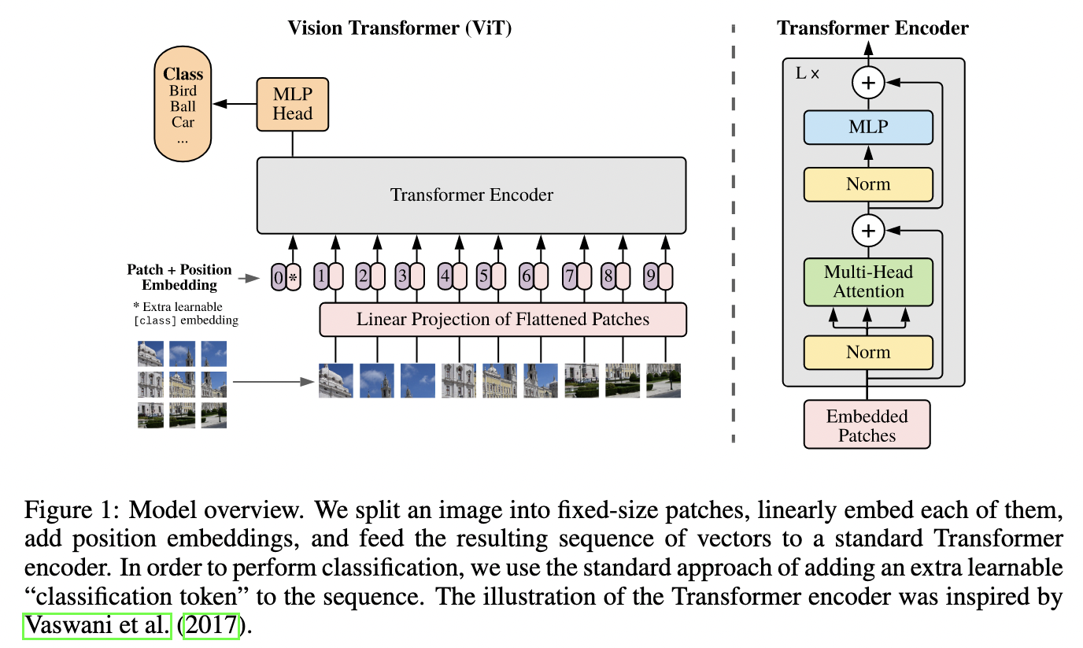
Model
Advantage: can use efficient and scalable Transformers architecture from NLP out of the box!

Slide 8
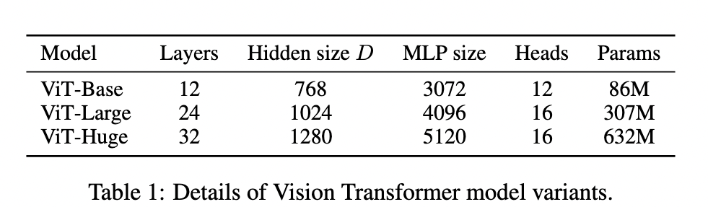
Model
Advantage: can use efficient and scalable Transformers architecture from NLP out of the box!

Slide 9
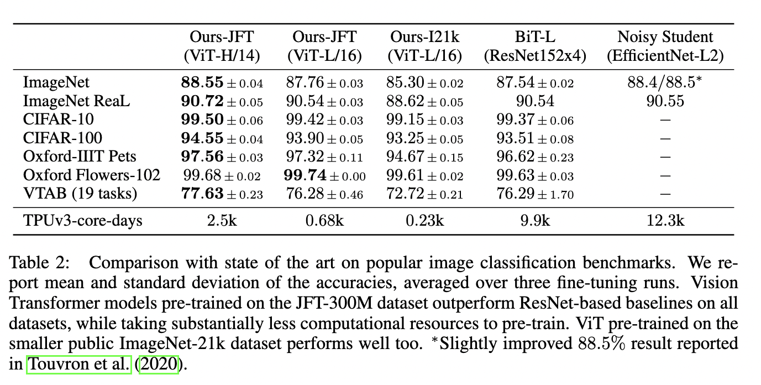
Model
Advantage: can use efficient and scalable Transformers architecture from NLP out of the box!

Slide 10
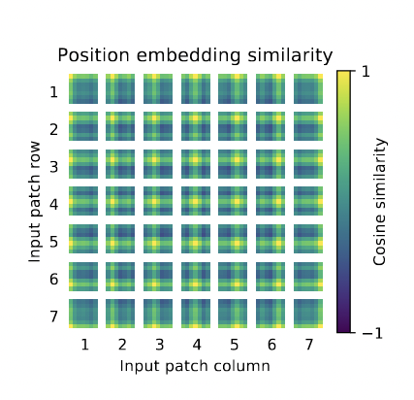
Model

Slide 11
Learning Transferable Visual Models From Natural Language Supervision
CLIP: Contrastive Language-Image Pretraining Alec Radford et. Al
https://openai.com/blog/clip/
https://arxiv.org/abs/2103.00020

Slide 12
Contributions
Caveat: training takes 30 days across 592 V100 GPUs (if you run it on AWS on-demand, you will need to fork out $1,000,000!)
A vision-language neural network model trained on 400M image-text pairs (pictures-captions in the web)
Training is to predict the most relevant text snippet given an image
Can perform well on tasks it is not directly trained to do (zero-shot learning)

Slide 13
Model
Text encoder: for embedding text
Image encoder: for embedding image
Do contrastive pretraining to learn good embeddings for these

Slide 14
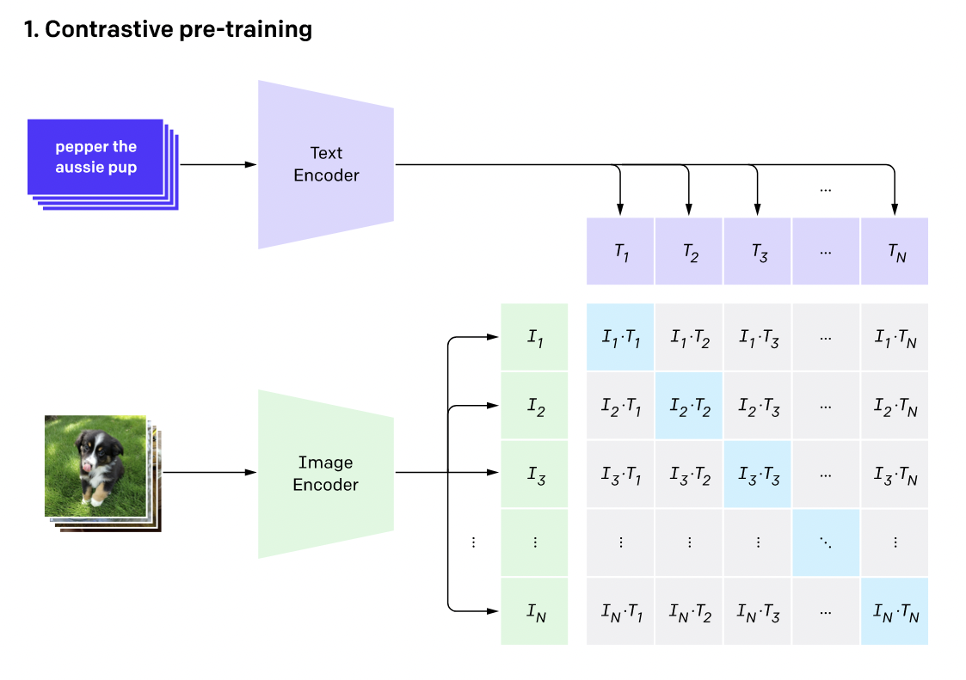
Model
Contrastive pre-training: an embedding for a text should be close to the embedding of an image it is a caption of (cosine-similarity)
Diagonal entries should have high cosine similarities
Non-diagonal entries should have low cosine similarities

Slide 15
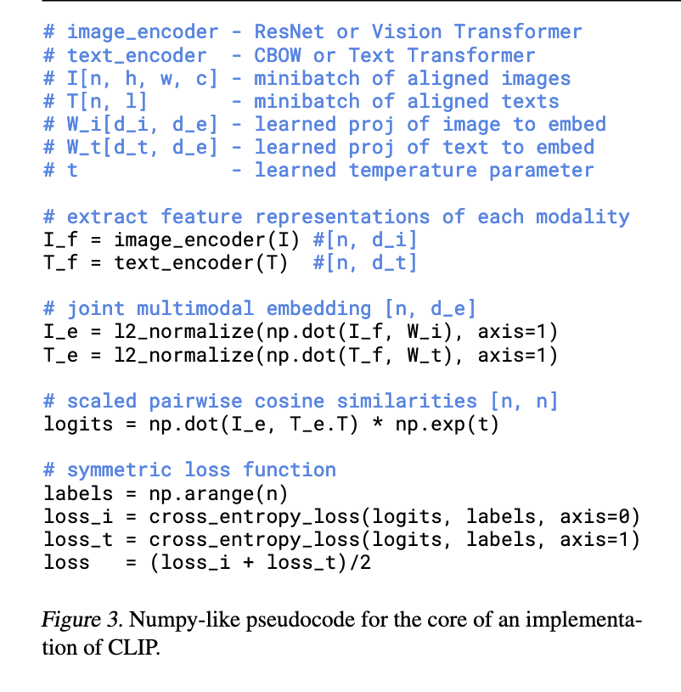
Model
Contrastive pre-training: an embedding for a text should be closer to the embedding of an image it is a caption of (cosine-similarity) and further from other images

Slide 16
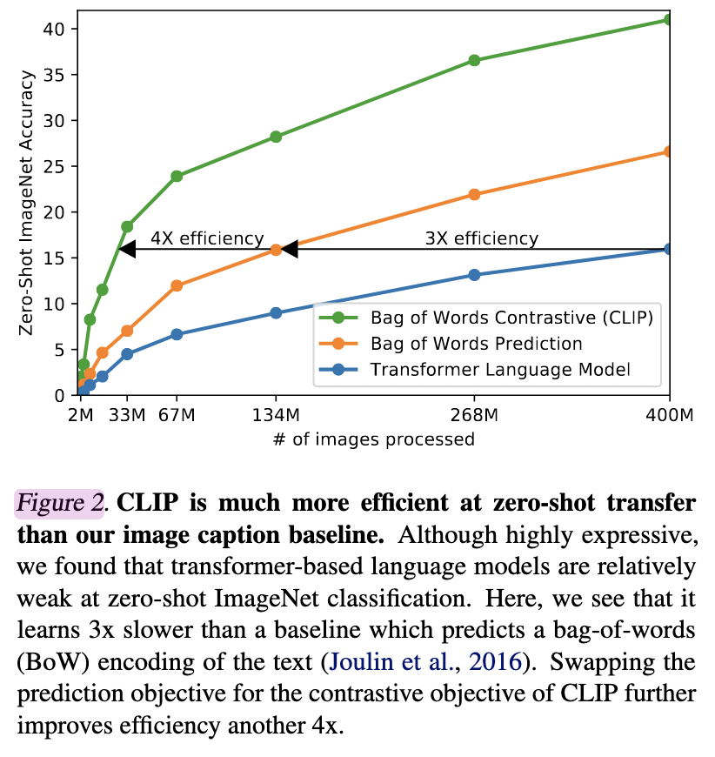
Model
CLIP: trained to predict which caption is paired with which image (contrastive objective)
Bag of Words prediction: trained to predict a bag-of-words caption of the image (predictive objective)
Transformer LM: trained to predict caption of an image (predictive objective)
Trained to predict the exact words of the text accompanying the image
Harder task

Slide 17
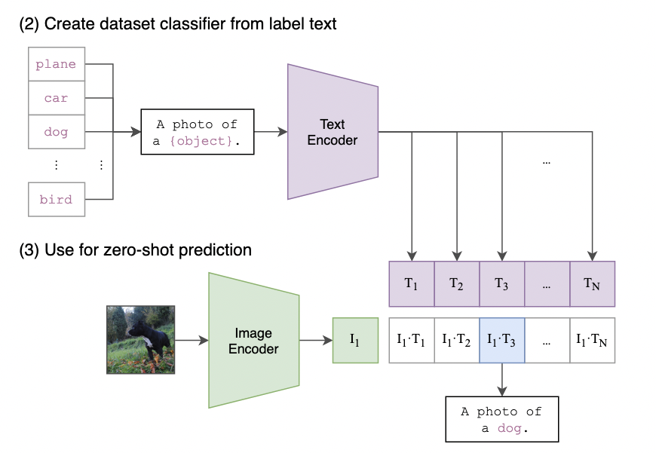
Model
need “prompts”
-- a sentence, to bridge gap between training and test
-- can be customized to each task
e.g., a photo of a {label}, a type of pet
Provide context for the task, also help for polysemy

Slide 18
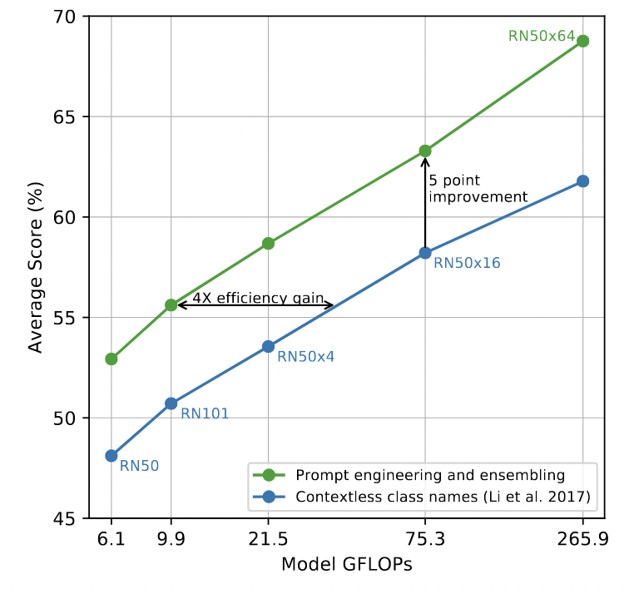
Prompts
need “prompts”
-- engineering: on satellite images, use “a satellite photo of a {label}”; on OCR, use quotes around the number/text to be recognized
-- ensembling: ensemble over multiple context prompts: “a photo of a big {label}”, “a photo of a small {label}

Slide 19
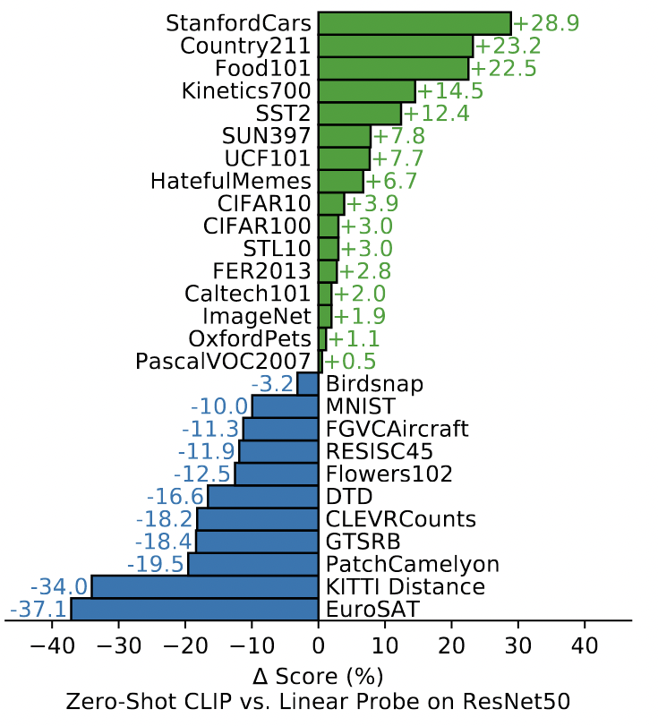
Zero-shot performance
Zero-shot CLIP is competitive with a fully supervised baseline. Across a 27 dataset eval suite, a zero-shot CLIP classifier outperforms a fully supervised linear classifier fitted on ResNet-50 features on 16 datasets, including ImageNet.
Linear Probe on ResNet50: add a linear classification layer (logistic regression) on top of ResNet50, fine-tuned on the target task in a supervised manner
Specialized, complex, or abstract tasks: satellite image classification, lymph node tumor detection, counting objects, ...

Slide 20
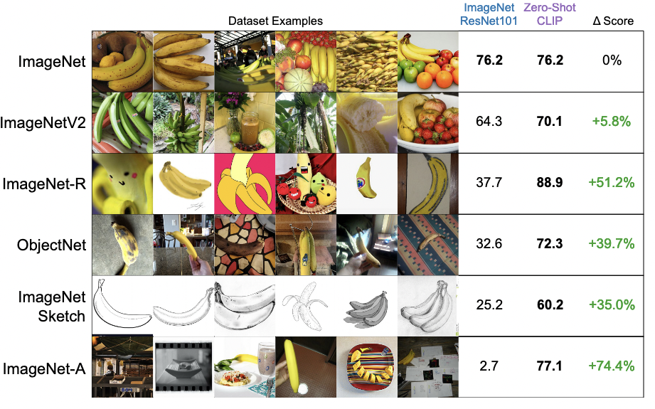
Robustness

Slide 21
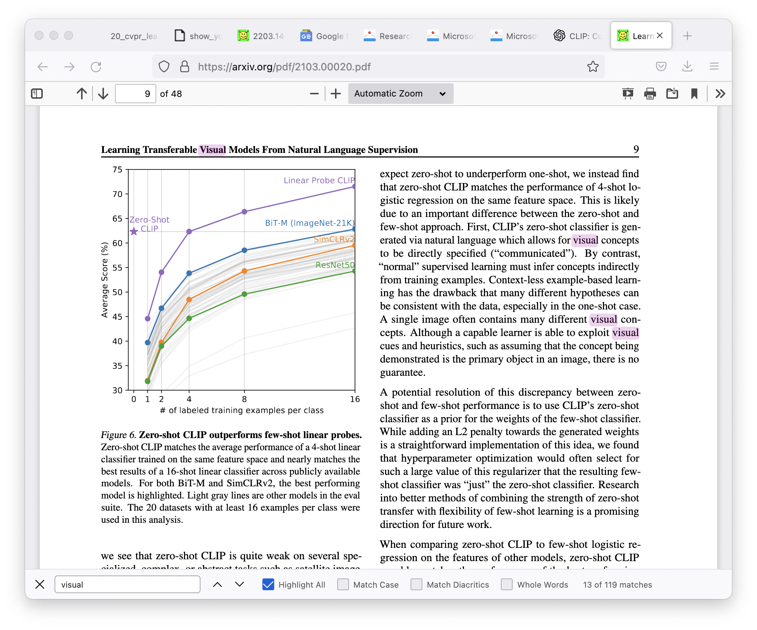
Zero-shot vs Few-shot

Slide 22
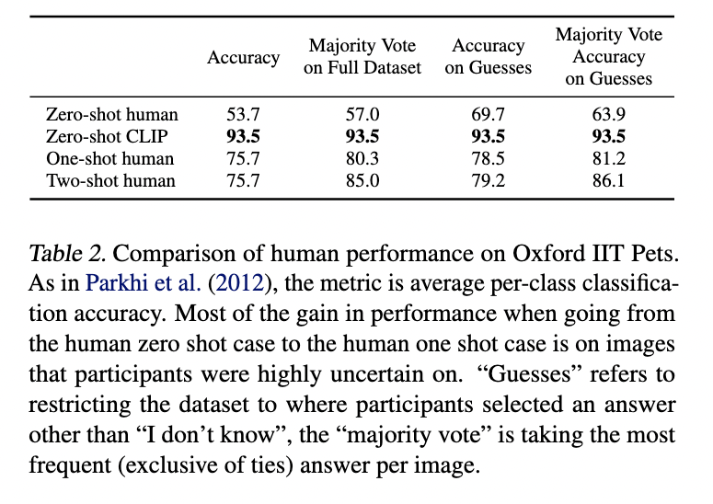
Human Performance
Human jumps from zero to one-shot, indicating humans know what they don’t know and are able to update their priors on the images they are most uncertain in based on a single example

Slide 23
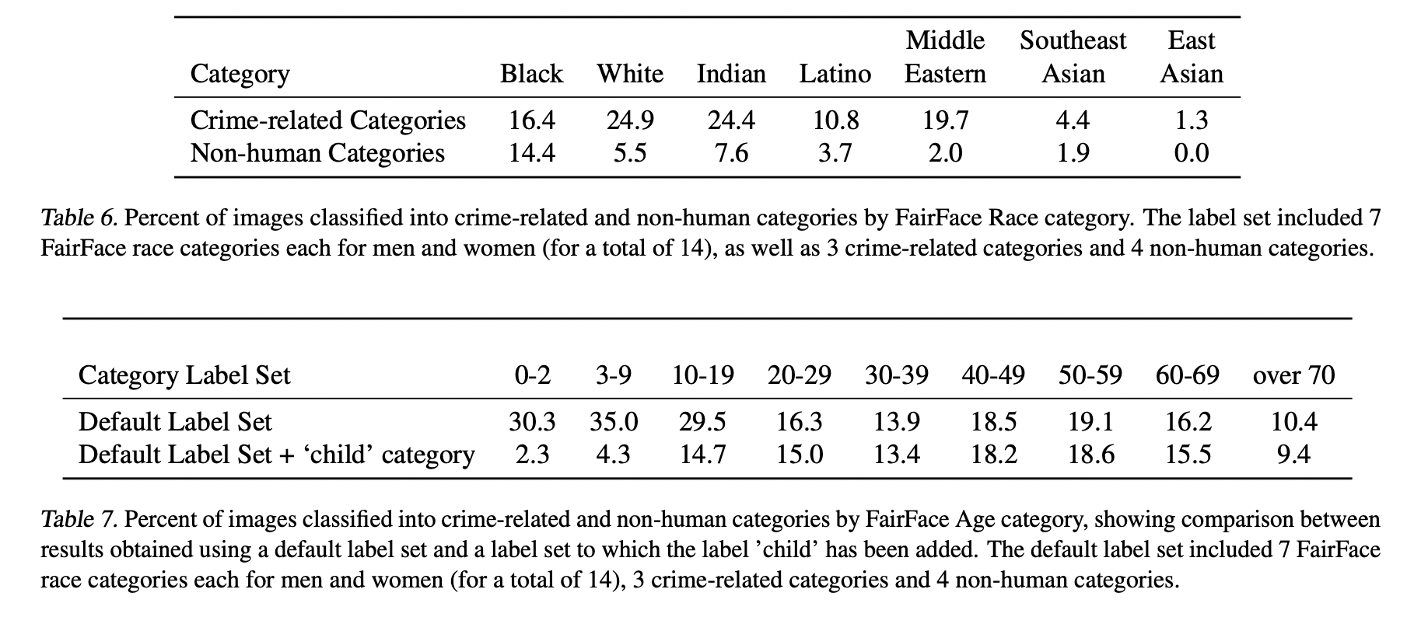
Limitation
Thief, criminal, suspicious person classes
Animal, gorilla, chimpanzee, orangutan classes
Adding appropriate categories can reduce misclassification

Slide 24
Conclusion
CLIP is designed to mitigate a number of major problems in standard deep learning approaches in computer vision
Costly dataset (e.g., ImageNet required 25K human annotators to annotate 14M images for 22K object categories)

Slide 25
Conclusion
CLIP is designed to mitigate a number of major problems in standard deep learning approaches in computer vision
Costly dataset
Narrow learning (e.g., ImageNet model is good at predicting 1K categories but that’s all it can do out of the box; if you need another tasks/classes, you need to build the dataset and fine-tune the model). In contrast, CLIP can be applied to a new task just by telling CLIP’s encoder the names of the task’s visual concepts.

Slide 26
Conclusion
CLIP is designed to mitigate a number of major problems in standard deep learning approaches in computer vision
Costly dataset
Narrow learning
Poor real-world performance: some models rely on spurious correlations to do well on a task (kind of like “cheating”, only optimizing performance on the benchmark, so will often perform badly when deployed in the wild). In contrast, CLIP is not trained on a particular benchmark so can’t cheat. When it is trained on ImageNet, it can improve its performance further on the task by almost a whooping 10%.

Slide 27
Take aways
CLIP is highly efficient, more efficient than other models trained to predict exact text given images
CLIP is flexible and general, learn a wide range of visual concepts directly from natural language, can do zero-shot performance on many tasks, and performance is more representative to real world, in-the-wild performance
Using task-agnostic pre-training on internet scale natural language, which is powering NLP, CLIP shows that such pre-training can be leveraged to improve performance of deep learning for other fields

Slide 28
Limitation
CLIP struggles on abstract/systematic tasks/fine-grained classification although it performs well on recognizing common objects
CLIP has poor generalization to images not covered in its pre-training data (e.g., MNIST)
CLIP can be sensitive to wording/phrasing and sometimes require trial and error “prompt engineering”
CLIP can perpetuate bias in its pre-training data

Slide 29
Cultural and Geographical Influences on Image Translatability of Words across Languages
Nikzad Khani, Isidora Tourni, Mohammad Sadegh Rasooli, Chris Callison-Burch, Derry Wijaya
NAACL 2021
https://aclanthology.org/2021.naacl-main.19/

Slide 30
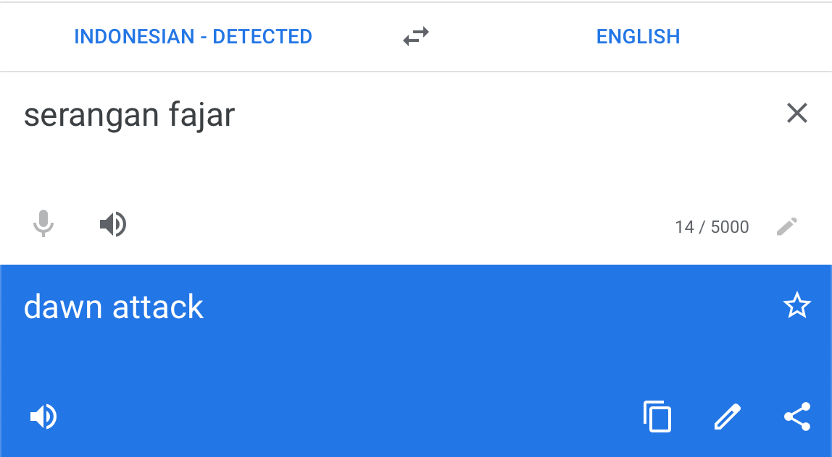
Notes:
Let's say you come across this Indonesian phrase, you don't know. first thing you may do is pop it in to Google translate, and it spits out "dawn attack". But, if you were to look up the images for the phrase.

Slide 31

Notes:
From the images, you can see that serangan fajar doesn't mean dawn attack. Instead, it should have been translated to bribing, political corruption or something of the sort.

Slide 32

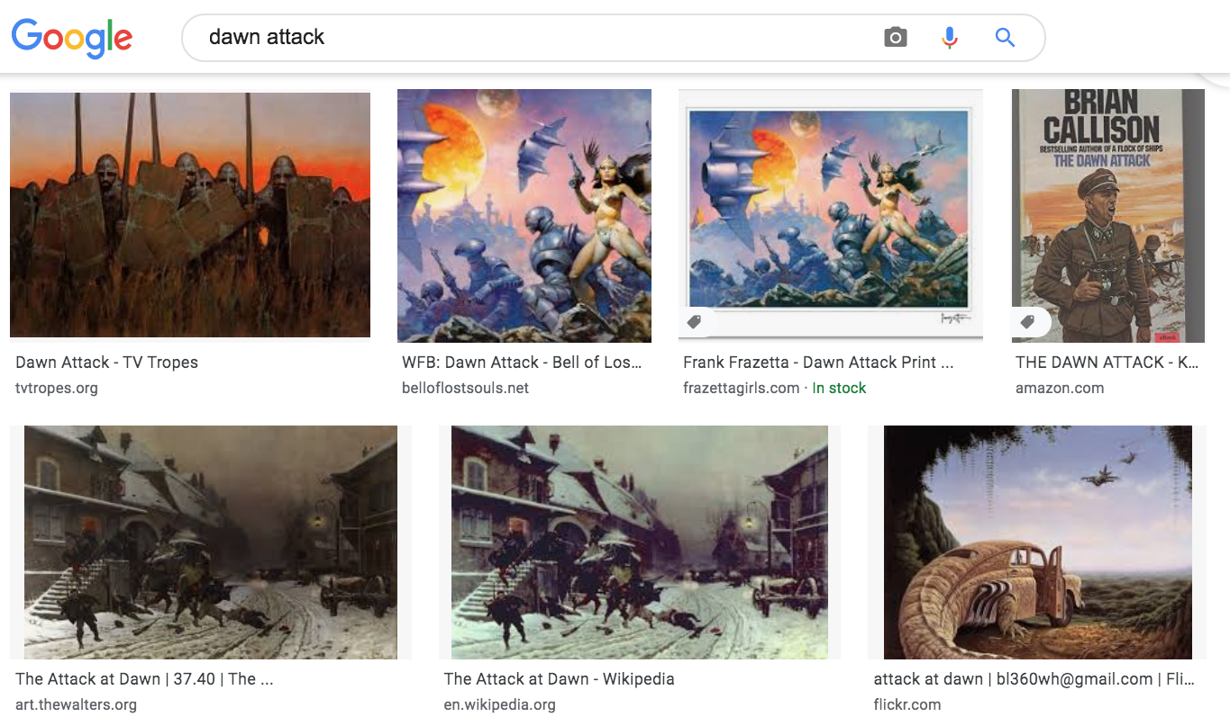
Notes:
Serangan fajar actually is better translated to "money politics" compared to "dawn attack". If we had incorporated images into our machine translation then we would have correctly identified the better translation. Now let's look at another example

Slide 33
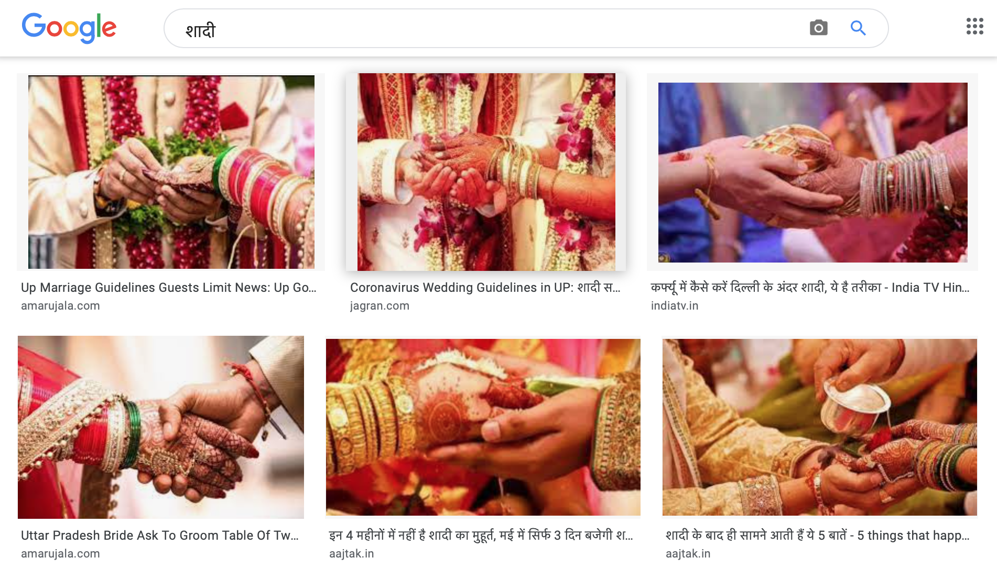
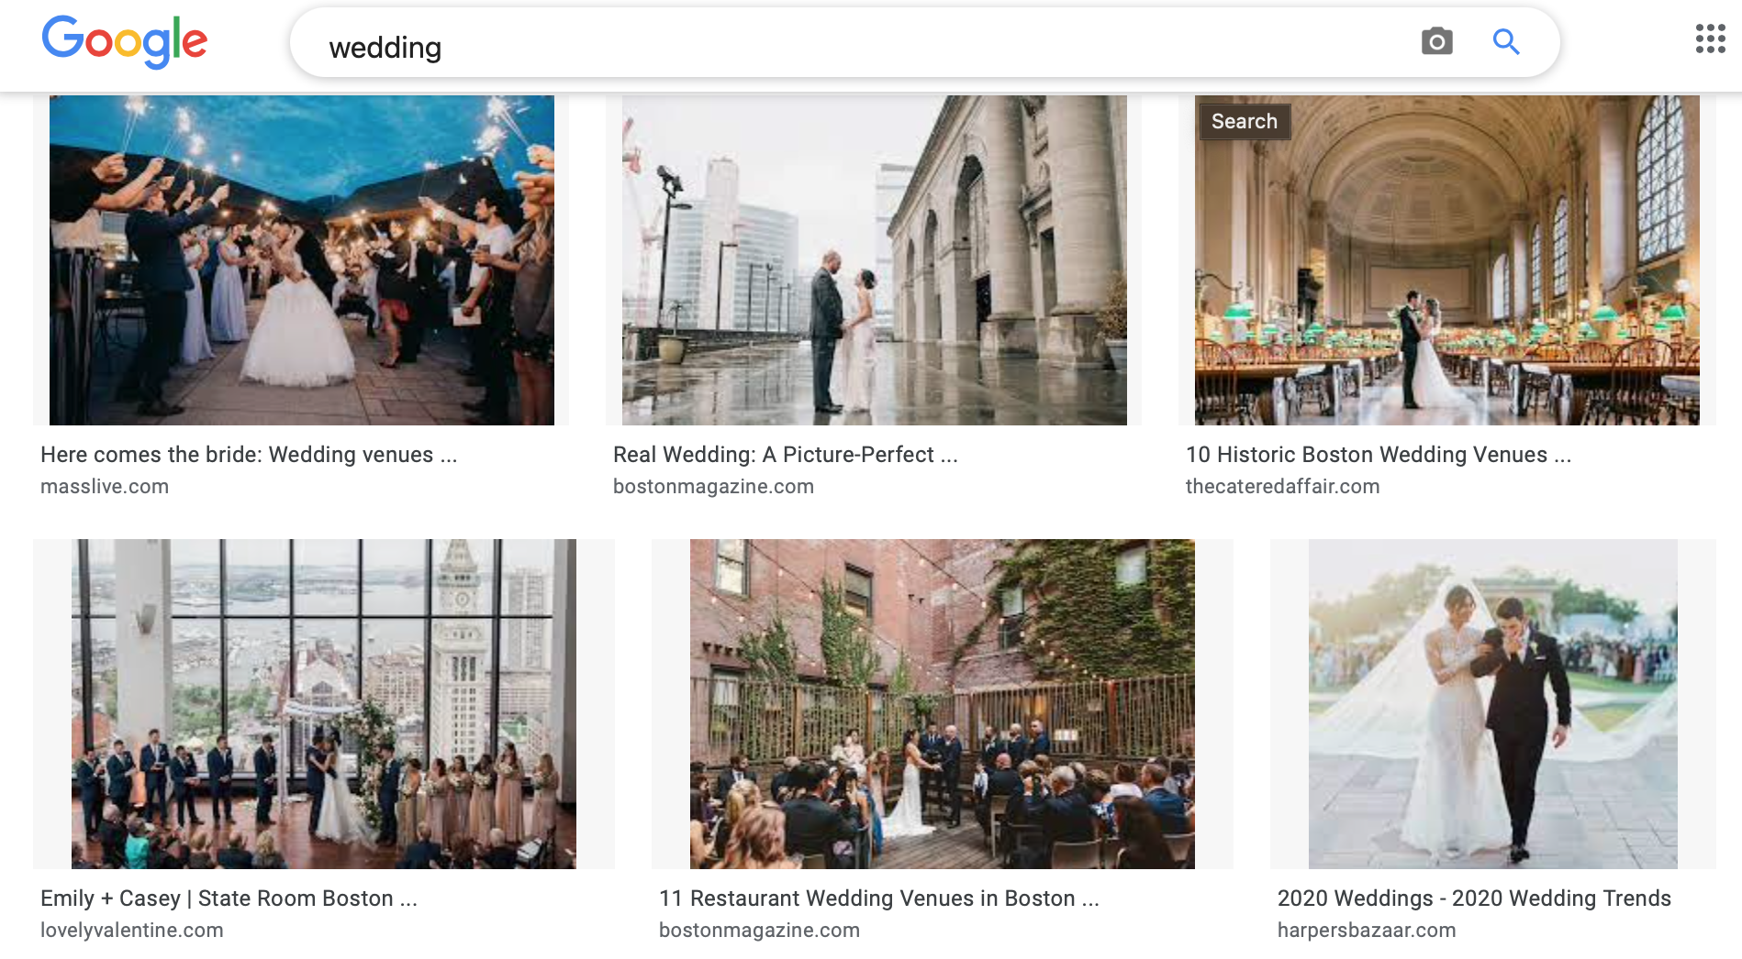
Notes:
Here we are given the images for wedding in Hindi and English, but we can see that if we used images to translate here, we wouldn't find the correct translation. This begs the question, when should should we use images for to aid machine translation? And how can we identify when images are aligned?

Slide 34
MMID Dataset
98 languages
10,000 words per language
100 images per word
Notes:
the Massively Multi-lingual Image Dataset or MMID. It contains 98 languages of which we will only study 19 language pairs, and up to 10,000 words per language with 100 images per word.

Slide 35
Languages Studied
19 language pairs were chosen such that every source language had two or more target languages with some shared characteristic in geography or culture.
Source | AZ | AZ | KO | KO | ZH | ZH | JA | JA | AR | AR | AR | UR | UR | ES | ES | FI | FI | AF | AF
Target | TR | RU | ZH | JA | JA | KO | ZH | KO | UR | FA | HE | AR | HI | FR | PT | HU | NO | NL | SW
Language Key Codes: AZ – Azerbaijani, TR – Turkish, RU – Russian, KO – Korean, JA – Japanese, ZH – Chinese, AR – Arabic, UR – Urdu, FA – Farsi, HE – Hebrew, HI – Hindi, ES – Spanish, PT – Portuguese, HU – Hungarian, FI – Finnish, NO – Norwegian, AF – Afrikaans, NL – Dutch, SW – Swahili
Notes:
The 19 language pairs we looked are shown in table below. The groups of language pairs separated by lines all share the same source language and were made strategically such that we can observe the influences of geographical proximity and culture on word translation. As you can see, we consider directionality in our translation. For example, the translation from Japanese to Korean differs from Korean to Japanese because the source words from MMID may be different.

Slide 36
Image embeddings
For a given language pair, source words were taken from MMID, then translated to target with Google Translate
We found both the source and target word’s images in MMID
Images passed through Res-Net 50, pre-trained on ImageNet
Each image embedding is a 2048-length vector
We call all 100 image embeddings for a word an image embedding cluster
We call a source word’s image embedding cluster and its translation’s image embedding cluster a word pair
Notes:
For each of our 19 language pairs, we translated the source words to our target language using Google Translate. We then searched for the source and target word's images in MMID. If we couldn't find the target word's images in MMID we discarded the word pair altogether. And if the google translation returned a phrase, we only took the last word of the phrase because MMID only contains words. We used the simple heuristic in choosing the last word to get rid of any articles such as "the, a, an" or equivalents in the beginning of the phrases. Lastly, we ran all the images through ResNet-50 pretrained on ImageNet, so we could get 100 image embedding vectors for each word which we call an image embedding cluster.

Slide 37
Image translatability as a metric
Intra-Cluster Similarity is a measure of how tight a set of images are. In other words, how diverse are the images for one search result.
Inter-Cluster Similarity is a measure of how different the two sets of images are. In other words, the similarity of the source word’s search results and its translation’s search results.
High Image Translatability means high inter and intra-cluster similarity
Image Translatability
Inter-Cluster Similarity
Intra-cluster Similarity
homogeneity
lower = overlapping cluster
= more similar images
median-max cosine
higher = tighter cluster = more similar images
Notes:
With a numerical representation of our images, we developed a metric for image translatability. Image translatability is defined by two parts. The first is intra-cluster similarity, which tells us how closely related images for a single language are related to each other. It's how 'tight" the cluster is. If the images are completely random we wouldn't hope to ever learn anything from them. That is why we need the images to be adequately similar for both languages. Inter-cluster similarity is how much the images of the two languages overlap. If they overlap completely then they are probably good translations; however, if they are disjoint then they might not be. If we want to say a word pair has high image translatability, then we will need both high inter-cluster similarity and intra-cluster similarity.

Slide 38
Language and Vision in Translation
Typological similarity between languages matters
Images of the word “park” in Afrikaans, Dutch, and Swahili
Notes:
It enables us for example to examine the language invariance assumption.
And also to question when and to what extent images can aid translation.
An alternative view would be that images may be different to some extent in different languages since they reflect the ways different people interact with these concepts; this may depend on where they live and the communities they live in
For example, images of the word breakfast in different languages may reflect the different cuisines of the communities that speak the languages.

Slide 39
Massively Multilingual Image Dataset (MMID)
100
10,000
250,000
Languages
Words per language
English word translations
100
35,000,000
Images per word
Total images
20TB
of data
http://multilingual-images.org/
Notes:
We release a corpus of images and their words and translations to facilitate further research into image-aided translation.
It consists of 100 languages, 10k words per language taken from the top 10k words of wikipedia for that language, and for each word its crowdsourced translations in English, and 100 images per word.
While most multimodal MT datasets are limited to a small set of European languages that come from the same language family, and are spoken by communities that are culturally and geographically close, the Massively Multilingual Image Dataset 070
(MMID) is constructed specifically to facilitate large-scale multilingual research in translating words via images.

Slide 40
Translatability of Words via Images
We measure similarities of image representations of words that are translations of each other
Language pairs with shared culture have improved image translatability, regardless of geographic proximity
Notes:
images of words are not always invariant across languages, and that language pairs with shared culture, meaning having either a common language family, ethnicity or religion, have improved image translatability (i.e., have more similar images for similar words) compared to its converse, regardless of their geographic proximity

Slide 41
Conclusion
Cultural similarities > geographical proximity between language pairs
Concrete words provide better image translatability
Image-aided machine translation can provide better context
Notes:
To sum up, cultural similarities will boost image translatability more than geographical proximity. Concrete words also improve image translatability, and lastly using images

